Slide 1
Connecting the Dots in a Topic Model
A Network Representation of Topics and Periodicals
Sanja Sarić
Centre for Information Modelling, University of Graz
Workshop on Information Visualization in the (Digital) Humanities
27.10.2022

Slide 2
INTRODUCTION
01
VISUALIZING TOPICS
02
NETWORKS OF TOPICS
03
CONCLUSION AND DISCUSSION
04
The corpus and method
Visualization of topic modeling results
How can networks be used to visualize topic modeling results
Lessons learned and future work

Slide 3
introduction

Slide 4
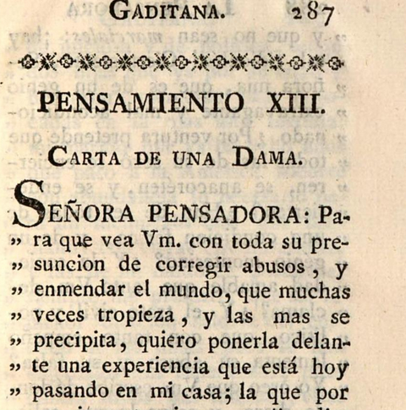
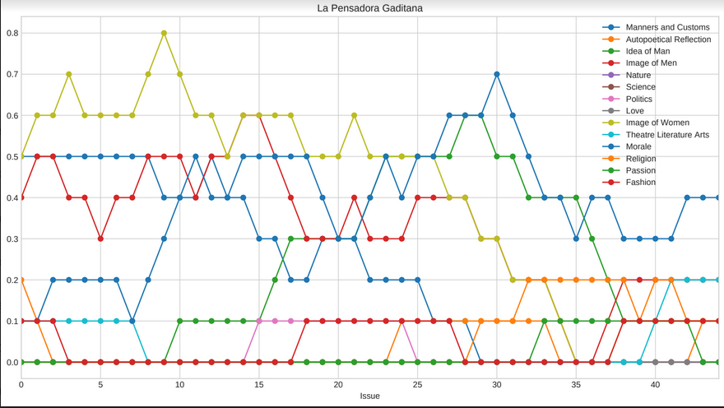
From Spectators …
01 INTRODUCTION
digital edition The Spectators in the international context
http://gams.uni-graz.at/spectators (Ertler et al. 2011-2018)
journalistic genre in the 18th century
created in England
imitations and translations in Europe
… to Distant Spectators
text mining to extend close reading expertise
explorative approach
project team: Martina Scholger, Bernhard Geiger, Elisabeth Hobisch, Philipp Koncar, Sanja Sarić, Yvonne Völkl, Christina Glatz
http://gams.uni-graz.at/dispecs (Scholger et al. 2018-2021)

Slide 5
Topic Modeling
01 INTRODUCTION
Python library dariah_topics (DARIAH-DE 2019) with MALLET (McCallum 2002-2018) based on Latent Dirichlet Allocation (LDA)
adapted and expanded Jupyter Notebooks for DiSpecs: https://github.com/distantspectators/DiSpecs
individual analysis of the French, Spanish and Italian sub-corpora
Topic Modeling with LDA
→ unsupervised probabilistic method that aims to identify hidden semantic structures in large text collections
Principle
→ frequently co-occurring words are most likely thematically related
Topics
→ lists of thematically or structurally related document tokens
Topics are not always subjects!
All topics contain all corpus tokens!

Slide 6
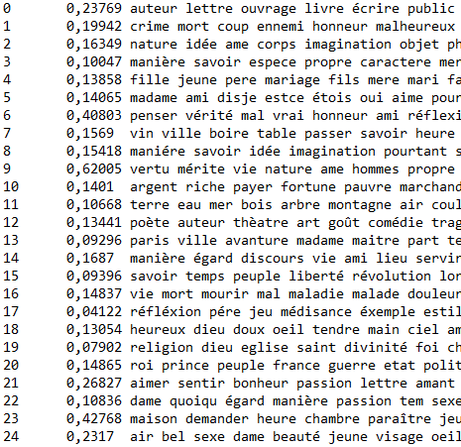
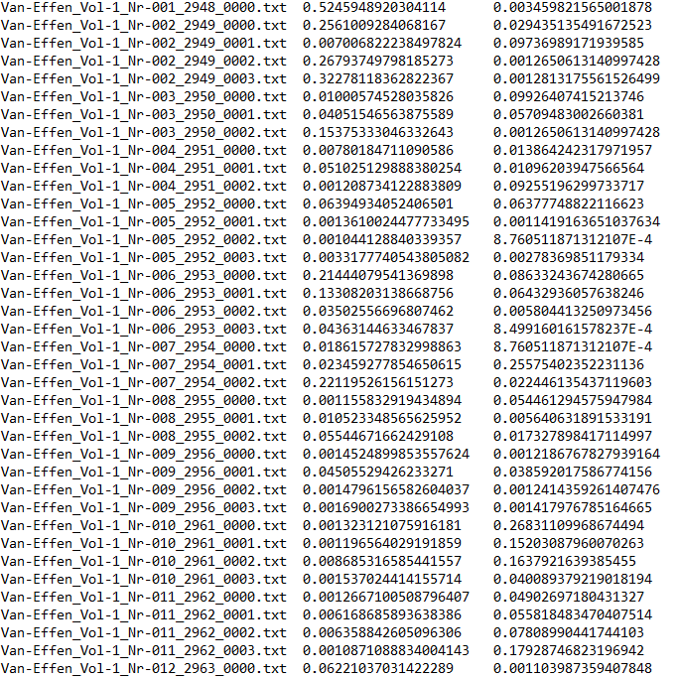
|Topic | Probability | Topic Keys |
|Document | Topic 0 | Topic 1 …
01 INTRODUCTION

Slide 7
|Topic | Probability | Topic Keys |
01 INTRODUCTION
philosophical ideas
marriage and family
(self-)reflection
virtuous behavior and practices
economy
theatre and opera
life vs death
church and religion
politics
love discourse
narrative vocabulary and dialogue
appearance of woman

Slide 8
visualizing topics

Slide 9
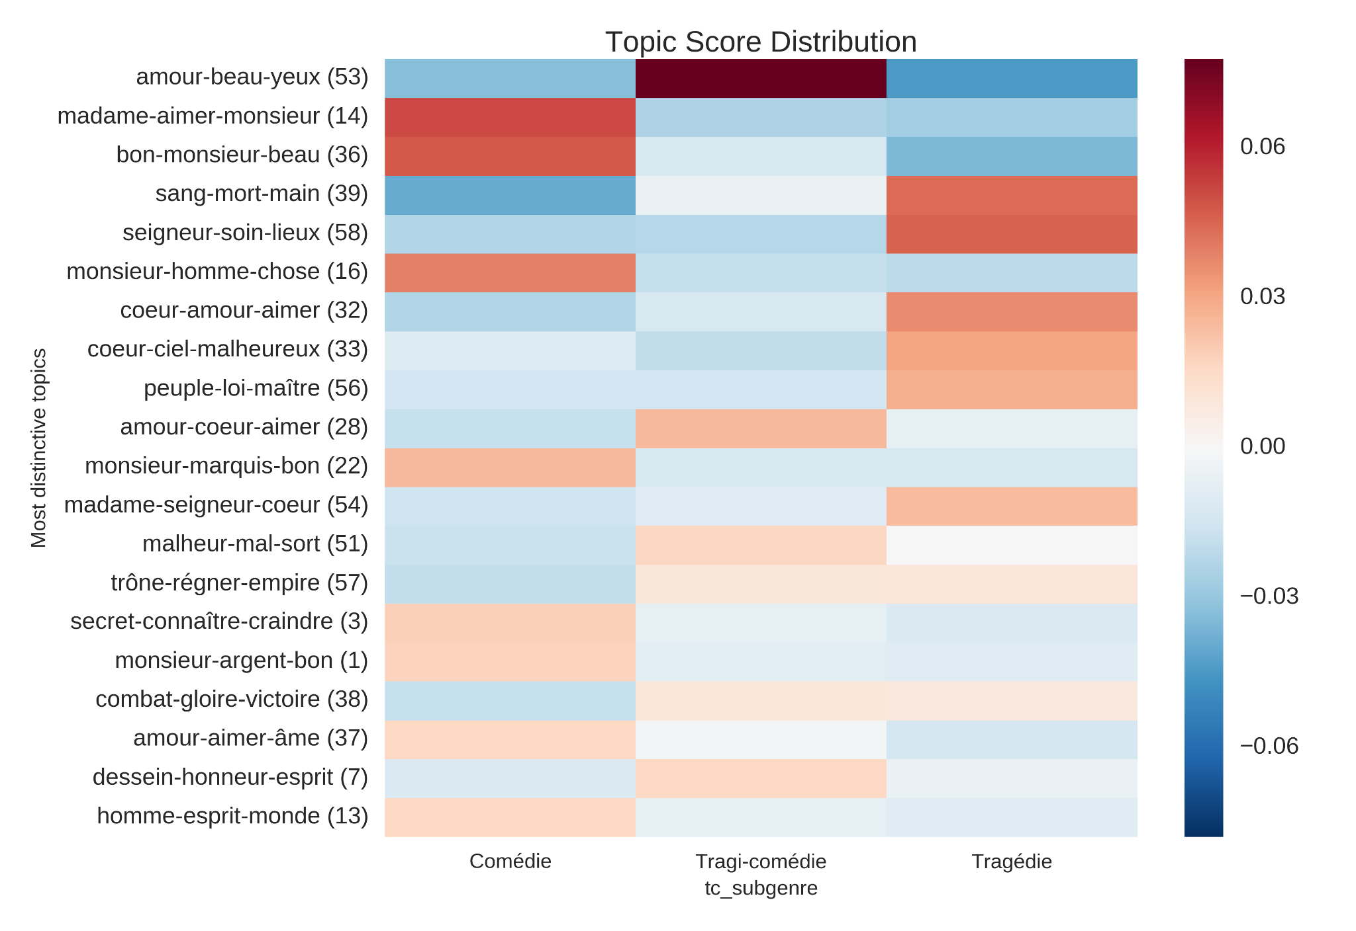
Common ways to
represent Topics
02 VISUALIZING TOPICS
Heat maps
Schöch 2017, Fig. 8

Slide 10
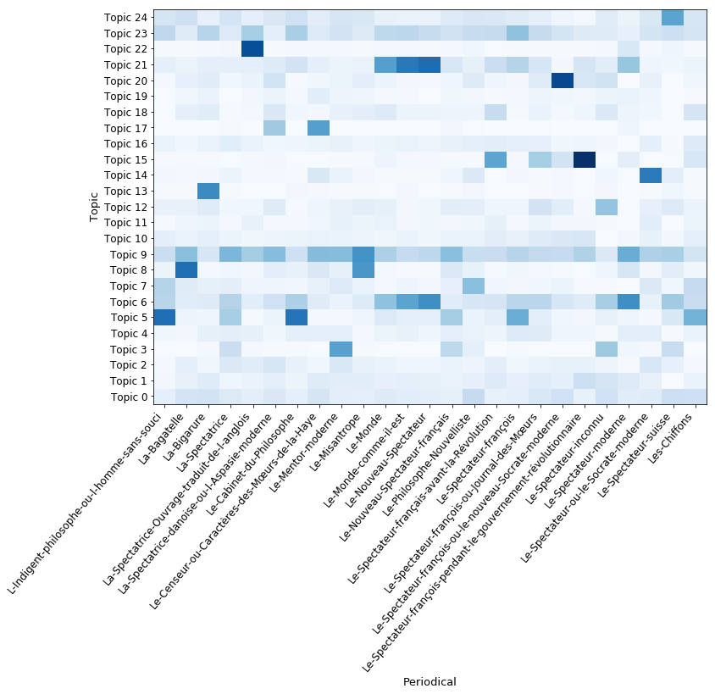
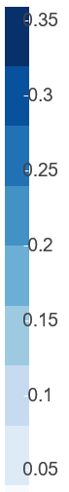
Common ways to
represent Topics
Heat maps
French Topics in DiSpecs
Scholger et al. (2019-2021)
02 VISUALIZING TOPICS
For the hoverable Bokeh view:
https://gams.uni-graz.at/archive/objects/o:dispecs.result.tm.fr/datastreams/HEATMAP_PERIODICALS/content

Slide 11
French Topics in DiSpecs
Scholger et al. (2019-2021)
02 VISUALIZING TOPICS
appearance of woman
behavior of women in public
love discourse
church and religion
life vs death
theatre and operas
economy
virtuous behavior and practices
(self-)reflection
marriage
philosophical ideas
For the hoverable Bokeh view:
https://gams.uni-graz.at/archive/objects/o:dispecs.result.tm.fr/datastreams/HEATMAP_PERIODICALS/content

Slide 12
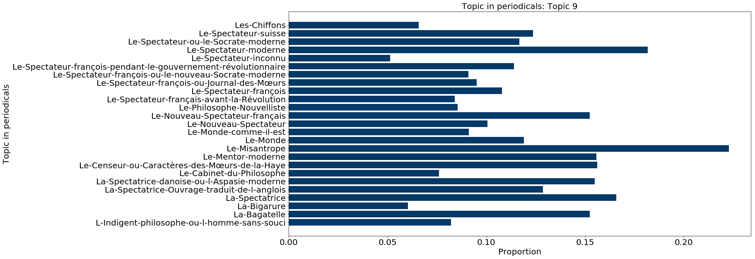
Common ways to
represent Topics
Bar charts
03 FRENCH TOPICS
02 VISUALIZING TOPICS
Topic 9 in French periodicals
virtuous behavior and practices
Scholger et al. (2019-2021)

Slide 13
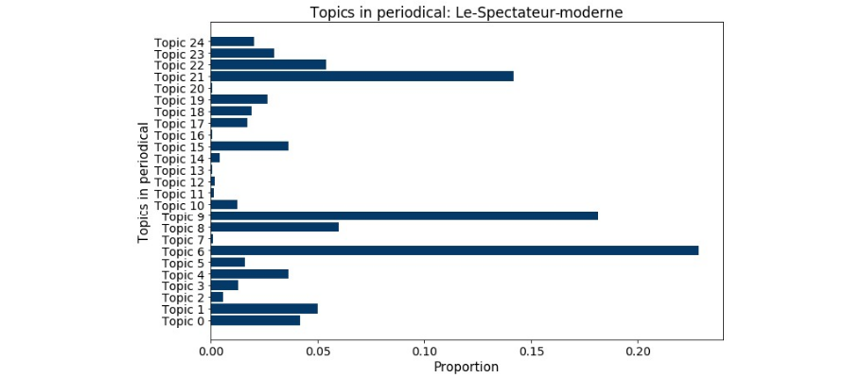
Common ways to
represent Topics
Bar charts
03 FRENCH TOPICS
02 VISUALIZING TOPICS
Topics in Le Spectateur moderne
Scholger et al. (2019-2021)

Slide 14
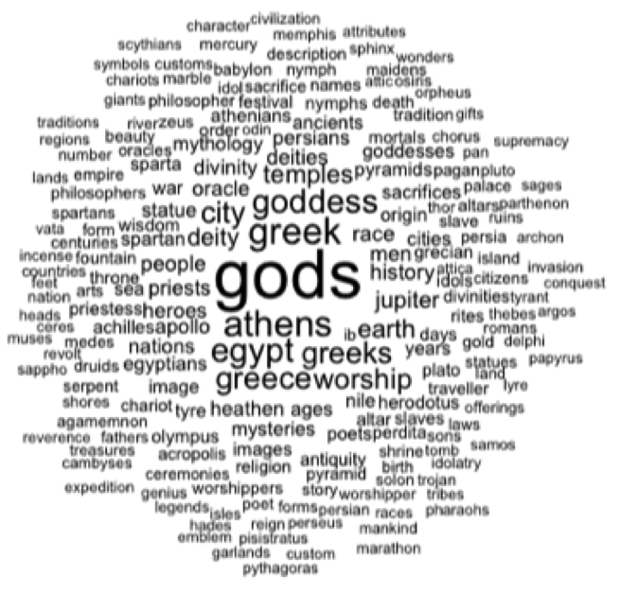
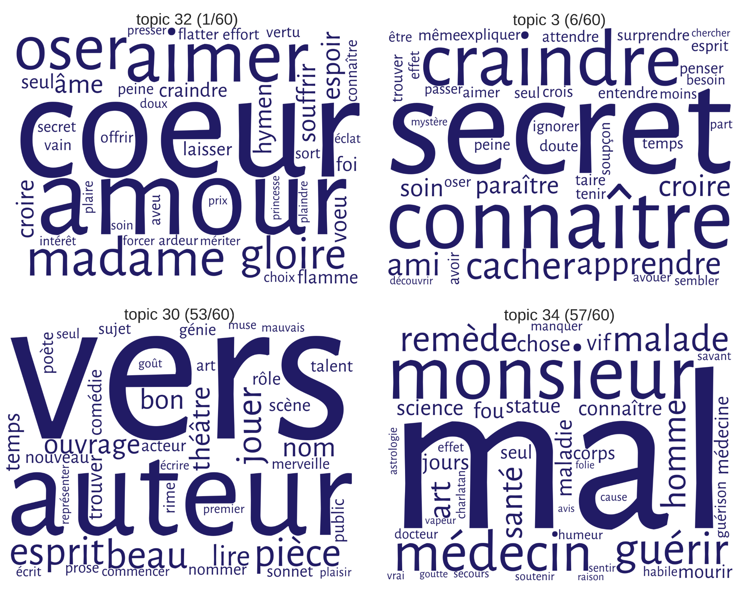
Common ways to
represent Topics
02 VISUALIZING TOPICS
Jockers 2016, Fig. 2
Word clouds
Schöch 2017, Fig. 4

Slide 15
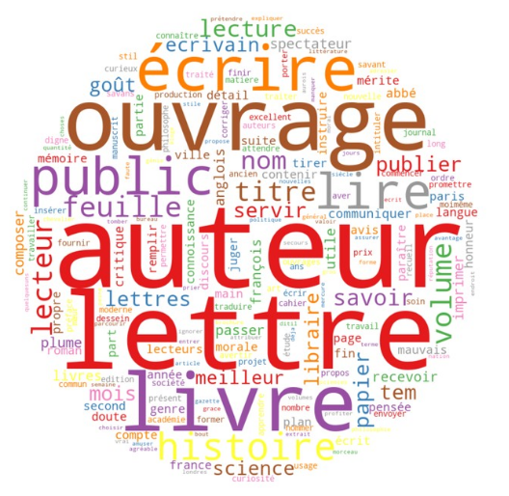
Common ways to
represent Topics
02 VISUALIZING TOPICS
Word clouds
French Topic 0
elements of the spectatorial communication process
Scholger et al. (2019-2021)

Slide 16
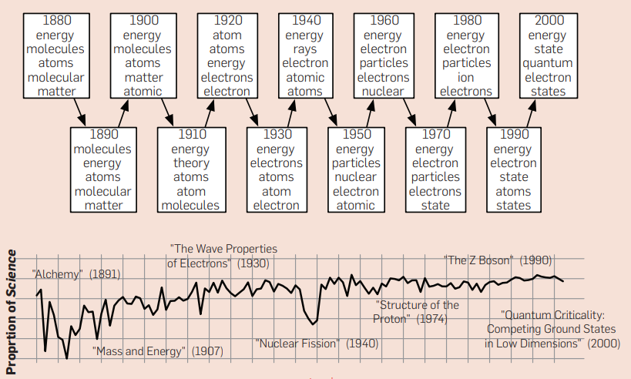
Common ways to
represent Topics
02 VISUALIZING TOPICS
Line diagrams
Blei 2012, Fig. 5

Slide 17
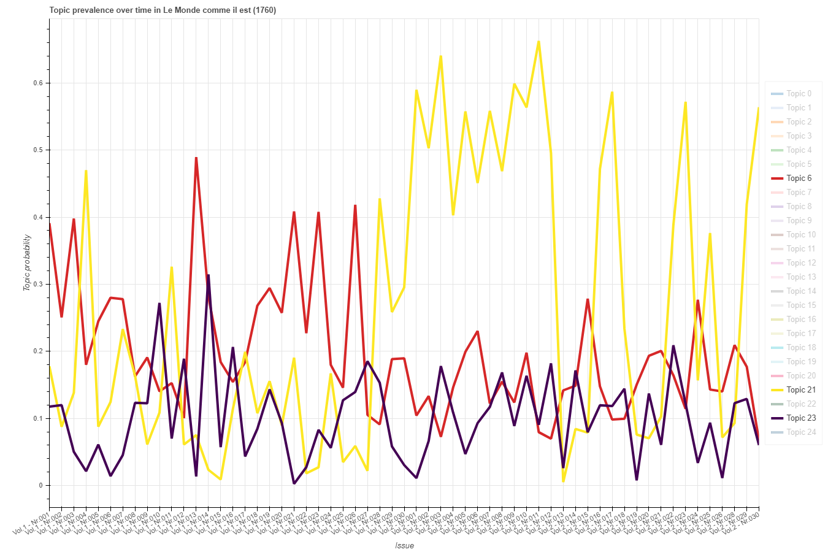
Common ways to
represent Topics
03 FRENCH TOPICS
02 VISUALIZING TOPICS
Line diagrams
6: (self-)reflection
21: love discourse
23: narrative vocabulary and dialogue
Topic prevalence over time in Le Monde comme il est
Scholger et al. (2019-2021)

Slide 18
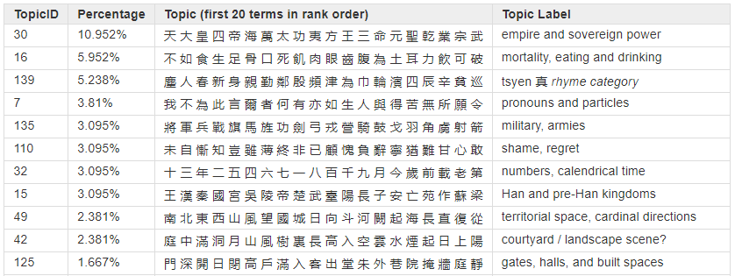
Common ways to represent Topics
02 VISUALIZING TOPICS
Data table
Broadwell et al. 2019, Table 4

Slide 19
visualizing topics
using networks

Slide 20
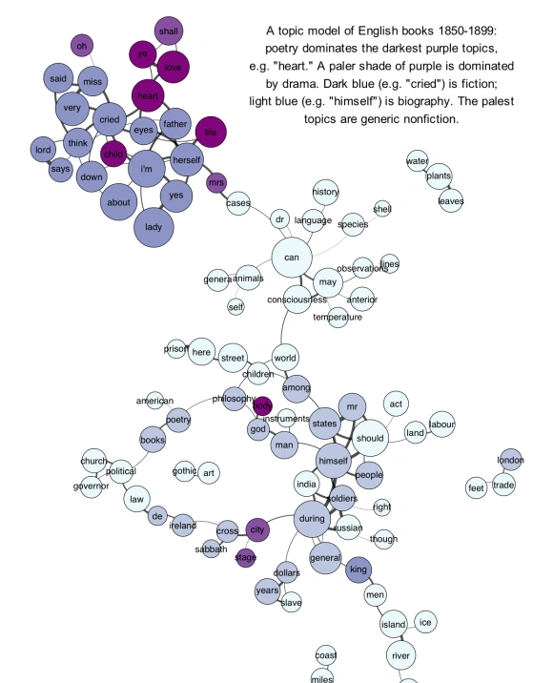
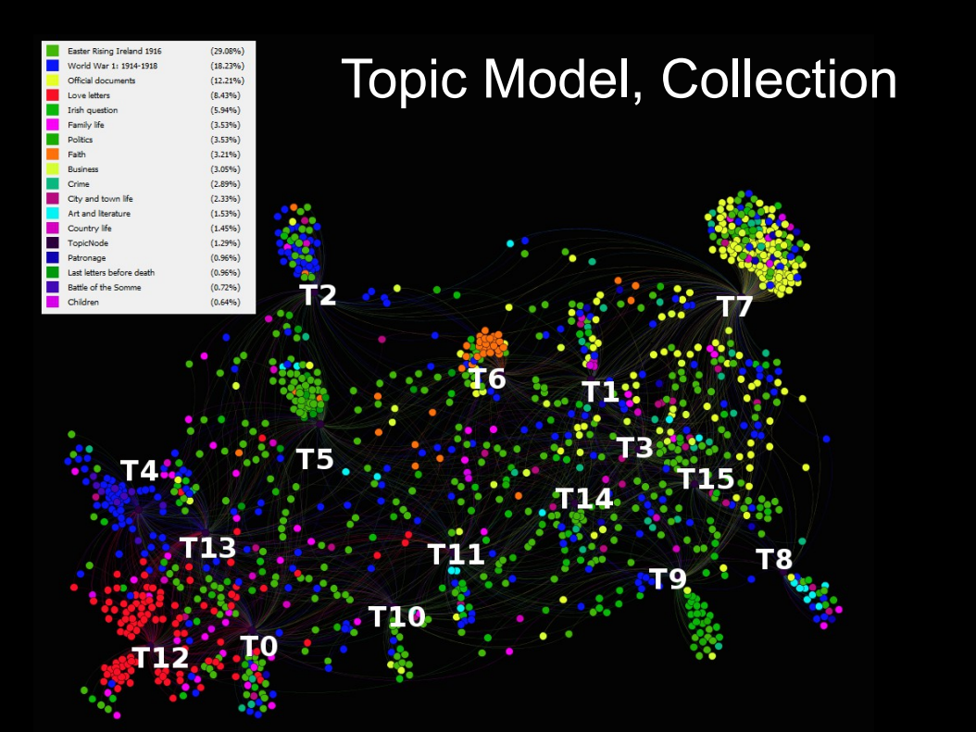
03 NETWORK OF TOPICS
Underwood 2012
Bleier 2015, 15

Slide 21
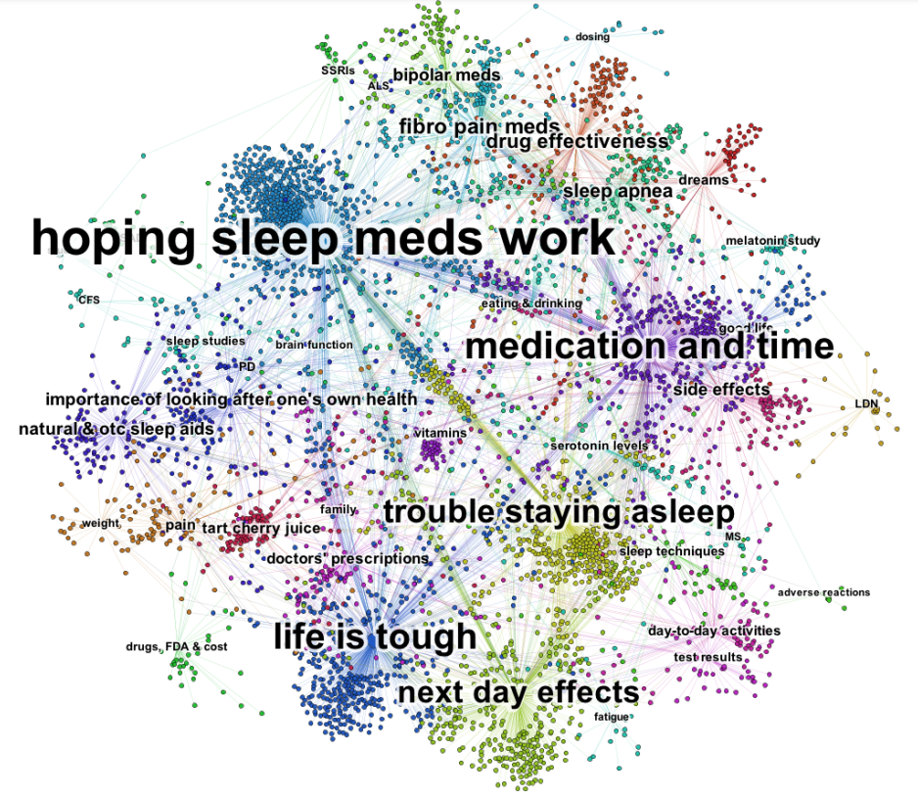
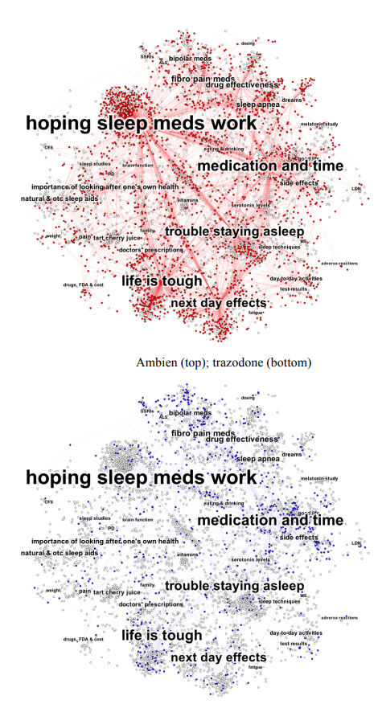
03 NETWORK OF TOPICS
Chen et al. 2013, 2-3

Slide 22
Aim of the network visualization in DiSpecs
03 NETWORK OF TOPICS
project with an explorative and experimental approach
representing topics and periodicals
… to answer questions such as:
Which periodicals share similar topics?
What can a network reveal about individual topics?
Can we compare topics with manually annotated keywords using a network?

Slide 23
Input data for Gephi (V. 0.9.2)
Nodes Edges
03 NETWORK OF TOPICS
Label | category | size | image
Topic 0 | topic | 23.768999 | NaN
L-Indigent-philosophe-ou-l-homme-sans-souci | periodical | 7.000000 | L'Indigent philosophe ou l'homme sans souci.png
La-Bagatelle | periodical | 100.000000 | La Bagatelle.png
La-Bigarure | periodical | 197.000000 | La Bigarure.png
La-Spectatrice | periodical | 15.000000 | La Spectatrice.png
La-Spectatrice-Ouvrage-traduit-de-l-anglois | periodical | 25.000000 | La Spectatrice. Ouvrage traduit de l'anglois.png
La-Spectatrice-danoise-ou-l-Aspasie-moderne | periodical | 83.000000 | La Spectatrice danoise, ou l'Aspasie moderne.png
… | … | … | …
Source | Target | Type | Weight
Topic 0 | L-Indigent-philosophe-ou-l-homme-sans-souci | Directed | 0.032563
Topic 0 | La-Bagatelle | Directed | 0.064769
Topic 0 | La-Bigarure | Directed | 0.068592
Topic 0 | La-Spectatrice | Directed | 0.048331
Topic 0 | La-Spectatrice-Ouvrage-traduit-de-l-anglois | Directed | 0.036678
... | ... | ... | ...
Topic 24 | Le-Spectateur-inconnu | Directed | 0.041099
Topic 24 | Le-Spectateur-moderne | Directed | 0.020350
Topic 24 | Le-Spectateur-ou-le-Socrate-moderne | Directed | 0.053887
Topic 24 | Le-Spectateur-suisse | Directed | 0.196733
Topic 24 | Les-Chiffons | Directed | 0.058543

Slide 24
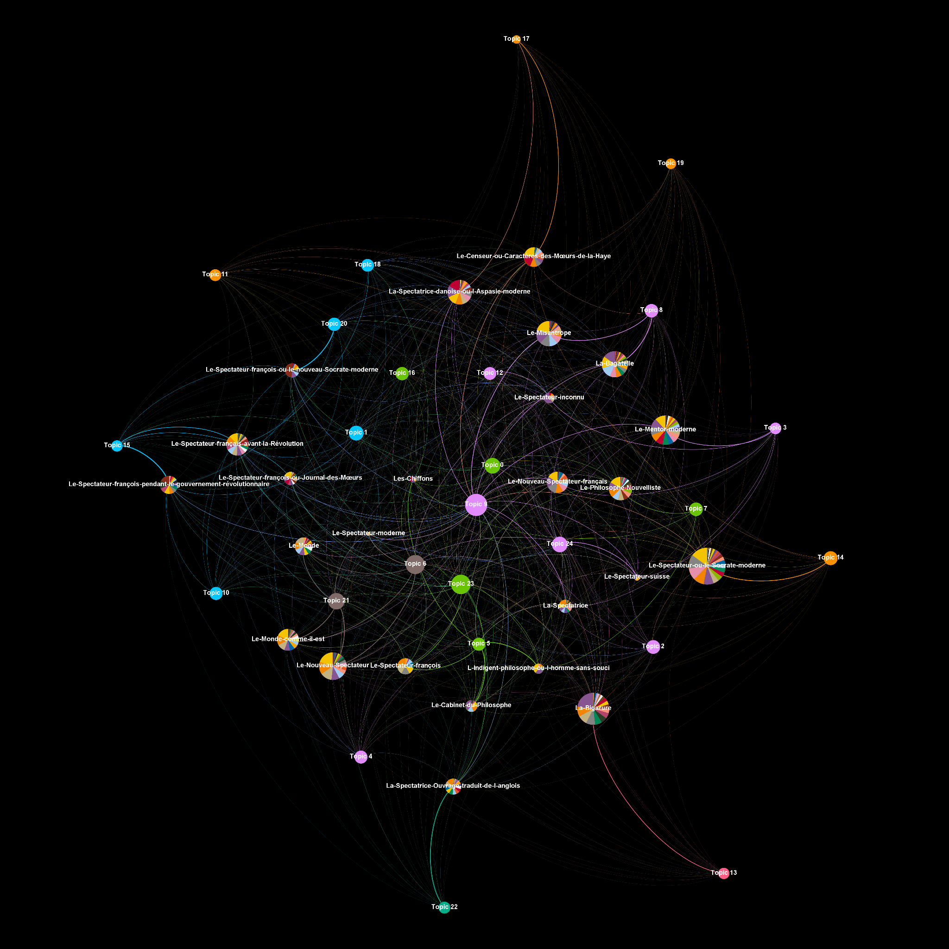
Network of topics and periodicals in DiSpecs
03 NETWORK OF TOPICS
View all topic modeling results on the DiSpecs website:
https://gams.uni-graz.at/archive/objects/context:dispecs/methods/sdef:Context/get?mode=tm-results
Topic network in French periodicals
Scholger et al. (2019-2021)

Slide 25
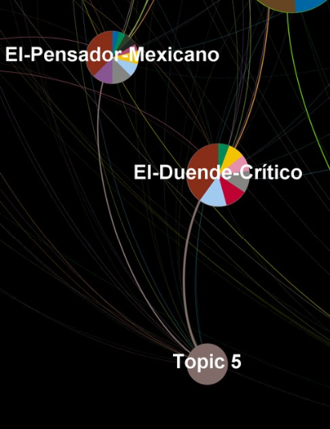
What can we read from the network visualization?
03 NETWORK OF TOPICS
Which periodicals share similar topics?
periodicals who write about similar subjects

Slide 26
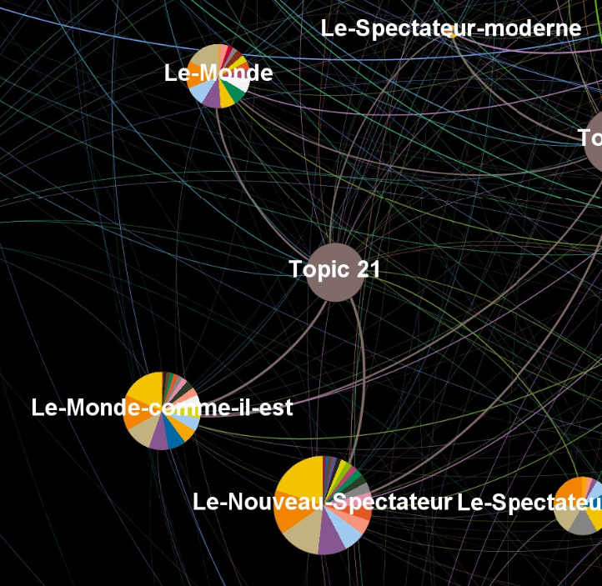
What can we read from the network visualization?
03 NETWORK OF TOPICS
Which periodicals share similar topics?
periodicals who write about similar subjects
periodicals of the same author/editor

Slide 27
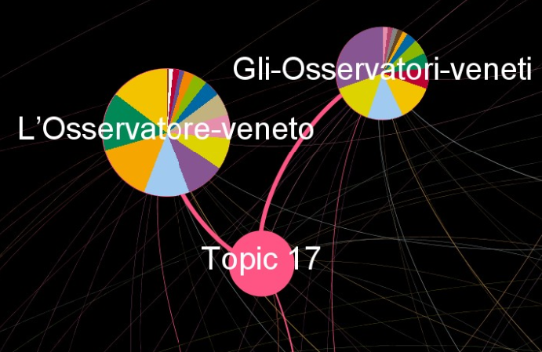
What can we read from the network visualization?
03 NETWORK OF TOPICS
Which periodicals share similar topics?
periodicals who write about similar subjects
periodicals of the same author/editor

Slide 28
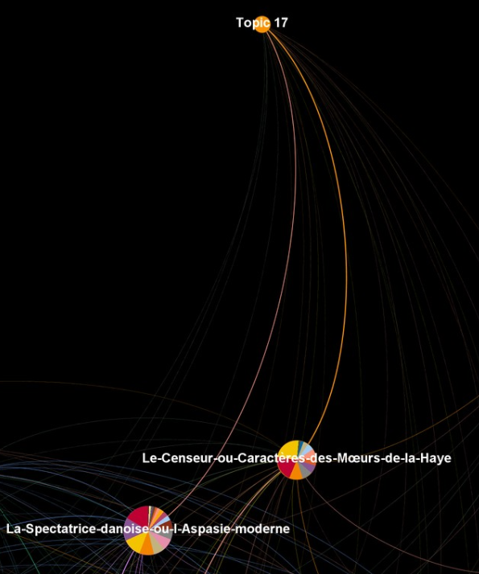
What can we read from the network visualization?
03 NETWORK OF TOPICS
Which periodicals share similar topics?
periodicals who write about similar subjects
periodicals of the same author/editor
periodicals with similar writing style

Slide 29
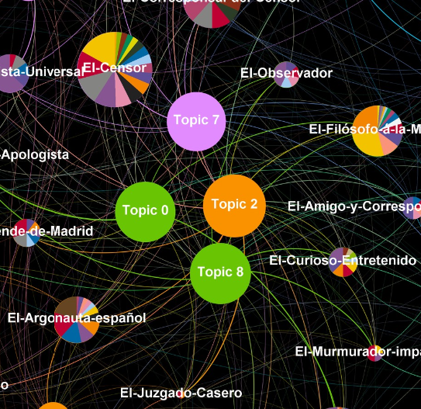
What can we read from the network visualization?
03 NETWORK OF TOPICS
Which periodicals share similar topics?
periodicals who write about similar subjects
periodicals of the same author/editor
periodicals with similar writing style
What can a network reveal about individual topics?
central (genre typical) vs. outlier (periodical specific) topics

Slide 30
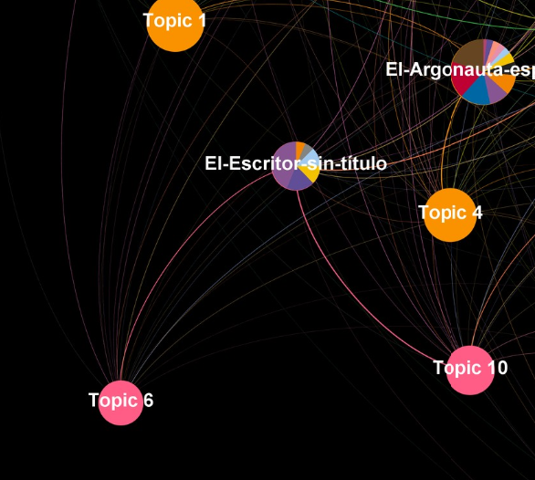
What can we read from the network visualization?
03 NETWORK OF TOPICS
Which periodicals share similar topics?
periodicals who write about similar subjects
periodicals of the same author/editor
periodicals with similar writing style
What can a network reveal about individual topics?
central (genre typical) vs. outlier (periodical specific) topics

Slide 31
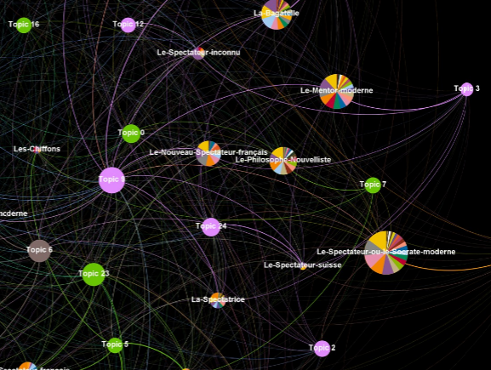
What can we read from the network visualization?
03 NETWORK OF TOPICS
Which periodicals share similar topics?
periodicals who write about similar subjects
periodicals of the same author/editor
periodicals with similar writing style
What can a network reveal about individual topics?
central (genre typical) vs. outlier (periodical specific) topics
modularity group?

Slide 32
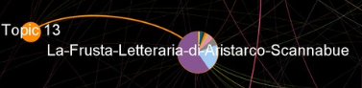
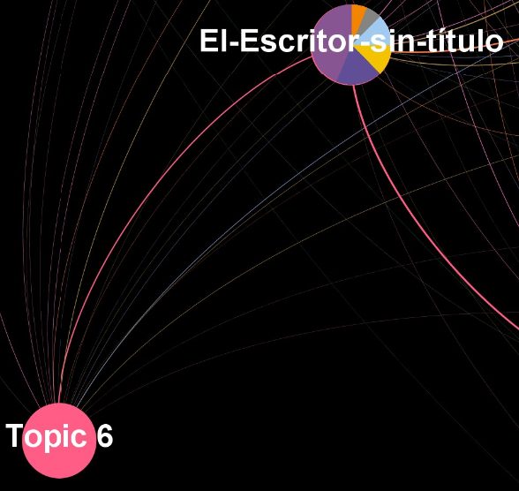
What can we read from the network visualization?
03 NETWORK OF TOPICS
Which periodicals share similar topics?
periodicals who write about similar subjects
periodicals of the same author/editor
periodicals with similar writing style
What can a network reveal about individual topics?
central (genre typical) vs. outlier (periodical specific) topics
modularity group?
Can we compare topics with manually annotated keywords using a network?

Slide 33
conclusion and discussion

Slide 34
Some lessons learned from theory and practice
04 CONCLUSION AND DISCUSSION
avoid information reduction
the danger of over-interpretation
a topic model is not really a network
for categorical data, choose colors of maximum contrast
descriptive labeling might be better for usability
document the chosen parameters and steps
networks have the potential to visualize various aspects of topics and documents
”
the network scientist / statistician in me twitches uncontrollably whenever he sees someone creating a network out of a topic model by picking the top-n topics associated with each document and using those as edges in a topic-document network
Scott Weingart

Slide 35
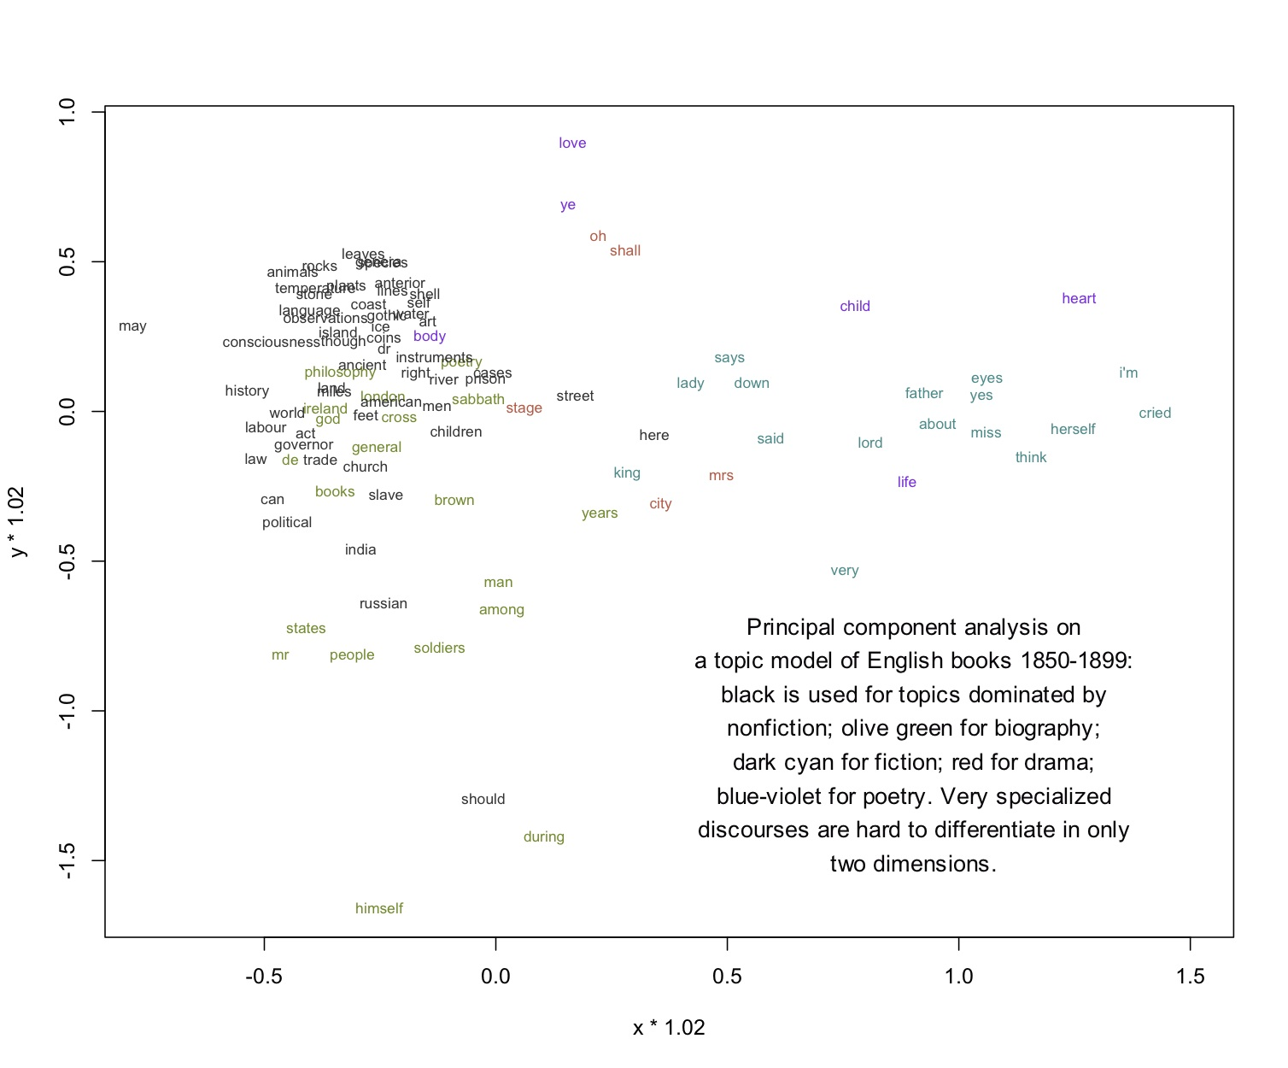
Alternatives
04 CONCLUSION AND DISCUSSION
Principal component analysis scatter plot
Underwood 2012

Slide 36
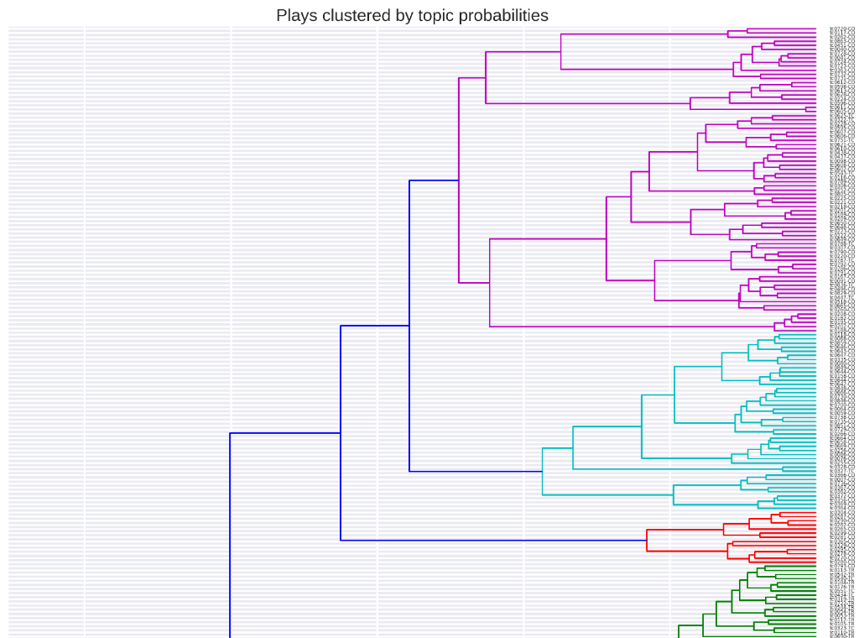
Alternatives
04 CONCLUSION AND DISCUSSION
Cluster dendrogram
Schöch 2017, Fig. 11

Slide 37
Bibliography
Blei, David M. (2012): “Probabilistic Topic Models”. URL: https://www.cs.columbia.edu/~blei/papers/Blei2012.pdf, DOI: 10.1145/2133806.2133826.
Bleier, Roman (2015): “Topic Modelling des Letters of 1916 Briefkorpus”. URL: http://gams.uni-graz.at/o:dhd2015.v.005.
Blondel, Vincent D; Guillaume, Jean-Loup; Lambiotte, Renaud; Lefebvre, Etienne (2008): “Fast unfolding of communities in large networks”. In: Journal of Statistical Mechanics: Theory and Experiment, 2008 (10). DOI: 10.1088/1742-5468/2008/10/P10008.
Chen, Annie; Sheble, Laura; Eichler, Gabriel (2013): “Topic Modeling and Network Visualization to Explore Patient Experiences”. DOI: 10.13140/2.1.4268.4481.
DARIAH-DE (2019): ”DARIAH Topics. Easy Topic Modeling in Python”. V. 2.0.1. URL: https://github.com/DARIAH-DE/Topics.
Ertler, Klaus-Dieter; Fuchs, Alexandra; Fischer-Pernkopf, Michaela; Hobisch, Elisabeth; Scholger, Martina; Völkl, Yvonne (2011-2018). “The Spectators in the International Context”. URL: https://gams.uni-graz.at/spectators.
McCallum, Andrew Kachites (2002-2020): “MALLET. A Machine Learning for Language Toolkit”. V. 2.0.8. URL: http://mallet.cs.umass.edu.
Underwood, Ted (2011): “Visualizing topic models”. URL: https://tedunderwood.com/2012/11/11/visualizing-topic-models/.
Scholger, Martina; Geiger, Bernhard; Hobisch, Elisabeth; Koncar, Philipp; Sarić, Sanja; Völkl, Yvonne; Glatz, Christina (2019-2021): “Distant Spectators (DiSpecs). Distant Reading for Periodicals of the Enlightenment”. URL: https://gams.uni-graz.at/dispecs.
Schöch, Christof (2017): “Topic Modeling Genre: An Exploration of French Classical and Enlightenment Drama“. In: Digital Humanities Quarterly 011, H. 2.URL: http://digitalhumanities.org:8081/dhq/vol/11/2/000291/000291.html.

Slide 38




THANKS
Does anyone have any thoughts on this?
https://gams.uni-graz.at/dispecs
Twitter #DiSpecs
@snjsrc
dispecs@uni-graz.at
sanja.saric@uni-graz.at
CC BY-SA
Foto © Ivan Stanimirov

